Slide 1
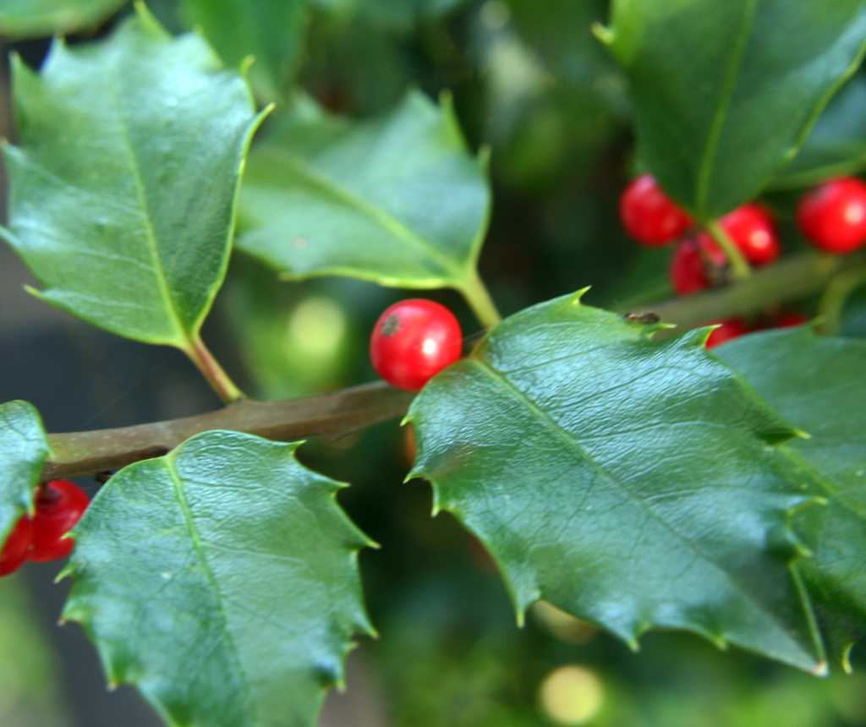
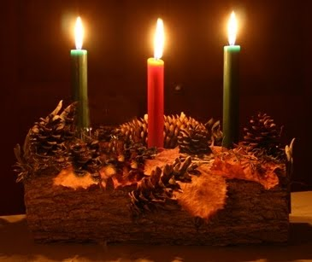


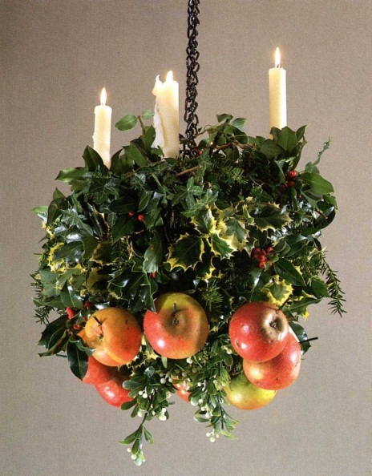
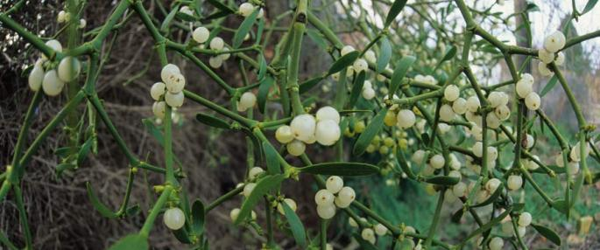
cwk
December 17th
The Coronation of William I
Starter:
LO:
Knowledge: Medieval celebratory festivals
Can you name these things?
Medieval Christmas Music

Slide 2
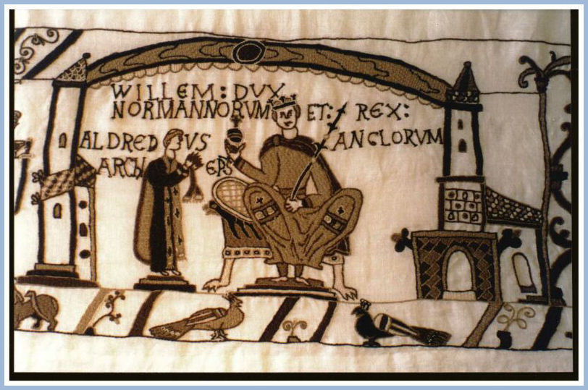
Christmas Coronation Chronicle
So at last on Christmas Day in the year of Our Lord, 1066, the fifth Indiction, the English assembled at London for the king's coronation, and a strong guard of Norman men-at-arms and knights was posted round the minster to prevent any treachery or disorder. And, in the presence of the bishops, abbots, and nobles of the whole realm of Albion, Archbishop Ealdred consecrated William duke of Normandy as king of the English and placed the royal crown on his head. This was done in the abbey church of St Peter the chief of the apostles, called Westminster, where the body of King Edward lies honourably buried.
But at the prompting of the devil, who hates everything good, a sudden disaster and portent of future catastrophes occurred. For when Archbishop Ealdred asked the English, and Geoffrey bishop of Coutances asked the Normans, if they would accept William as their king, all of them gladly shouted out with one voice, if not in one language, that they would. The armed guard outside, hearing the tumult of the joyful crowd in the church and the harsh accents of a foreign tongue, imagined that some treachery was afoot, and rashly set fire to some of the buildings. The fire spread rapidly from house to house; the crowd who had been rejoicing in the church took fright and throngs of men and women of every rank and condition rushed out of the church in frantic haste. Only the bishops and a few clergy and monks remained, terrified, in the sanctuary, and with difficulty completed the consecration of the king who was trembling from head to foot. Almost all the rest made for the scene of conflagration, some to fight the flames and many others hoping to find loot for themselves in the general confusion. The English, after hearing of the perpetration of such misdeeds, never again trusted the Normans who seemed to have betrayed them, but nursed their anger and bided their time to take revenge.

Slide 3
Task: Norman Party Planners
Using the information on the cards, plan a celebration to go with William's coronation.
Tips:
You are trying to win over your new subjects so bring in as many of their winter customs as you can.
Include an epic poem about how amazing William's victory was. This should be written in rhyming couplet, haiku or limerick form.

Slide 4
Attachments
Christmas Coronation Chronicle.wma

